Slide 1
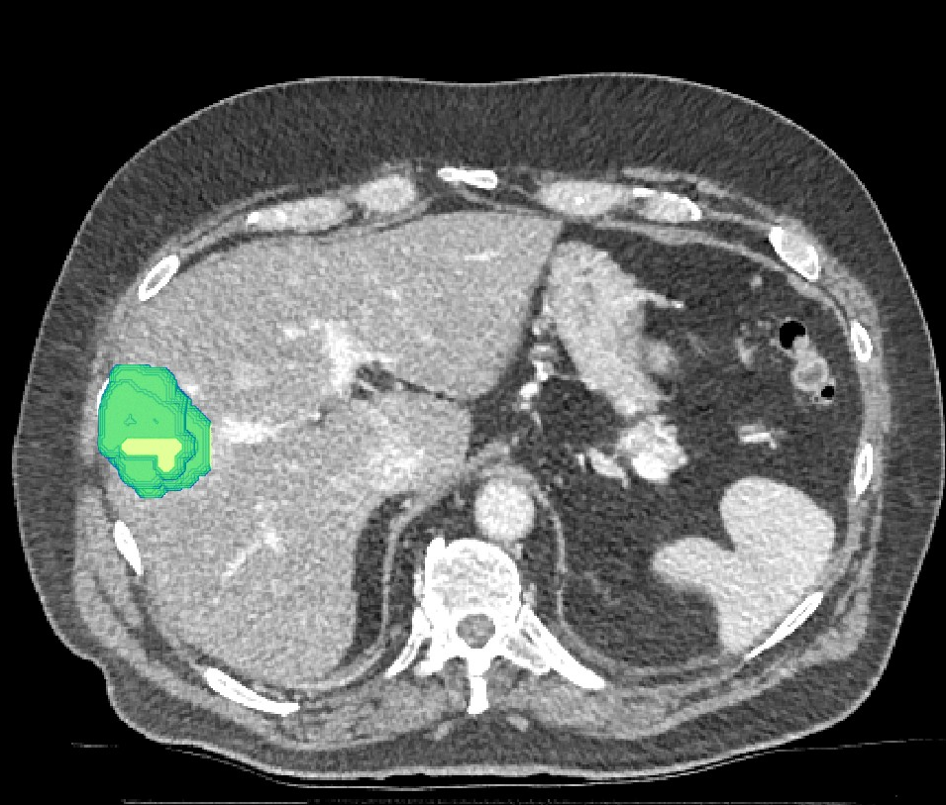
Unet:
CNN For Biomedical
Image-Segmentation

Slide 2
Layout of Presentation
Abstract
Proposed U-net (as in paper)
Dataset Used
Our pipeline
Operations Involved
Evaluation metrics used
Performance results

Slide 3
Abstract
The segmentation of biomedical images typically deals with partitioning an image into multiple regions representing anatomical objects of interest.
A variety of medical image segmentation problems present significant technical challenges, including heterogeneous pixel intensities, noisy/ill-defined boundaries, and irregular shapes with high variability.
This paper uses a convolutional neural network to train the model and perform image segmentation.
The architecture consists of a contracting path to capture context and a symmetric expanding path that enables precise localization.

Slide 4
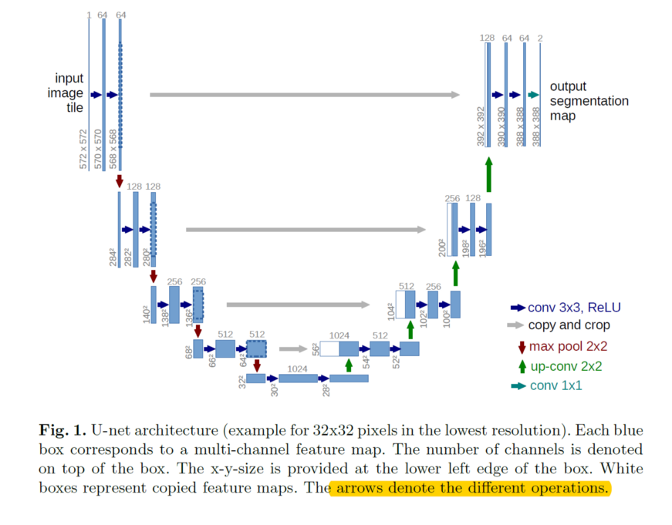
Proposed U-net (in paper)
We can see that the network is composed of Convolution Operation, Max Pooling, ReLU Activation, Concatenation and Up Sampling Layers.

Slide 5
DATASET PREPROCESSING TECHNIQUES
Dataset used -> kaggle data-science-bowl-2018.
Preprocessing techniques -> The image provided in the above dataset is n * n pixels which is reduced to 128 * 128 prior to training model.

Slide 6
Our Pipeline
We use a slightly different channel width than the initially proposed architecture in the paper.

Slide 7
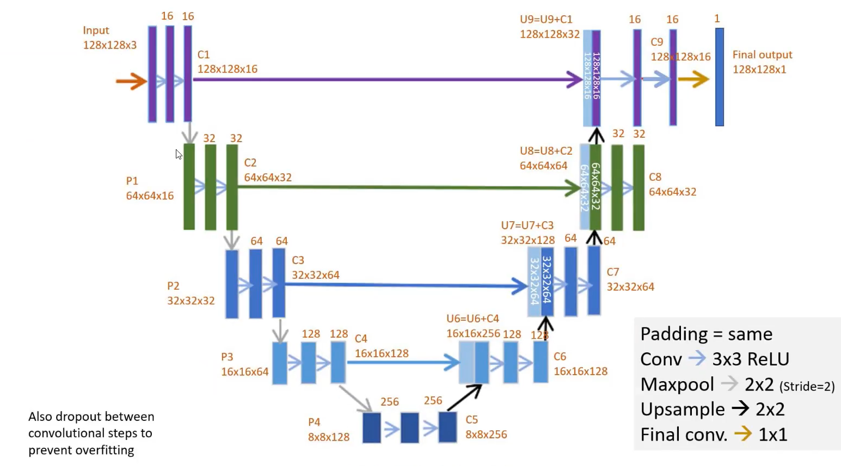
Pipeline

Slide 8
What else is different?
Used different Optimizer → The original paper used stochastic gradient descent optimizer, we just used an Adam Optimizer.
Used different loss function → The original paper have used softmax with cross entropy loss function, we just used an binary_crossentropy and sigmoid function.

Slide 9
Operations Involved
Convolution, max pooling(down scaling),relu activations and up sampling

Slide 10
Convolution
We are using a 3x3 kernel for convolution and ReLu activation.

Slide 11
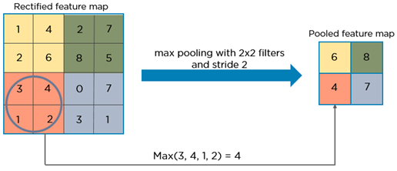
Max pooling
We are max pooling the convolutional layers on the left side using a 2x2 filter.
This is to get "WHAT" is present in the image rather than "WHERE" is it present.

Slide 12
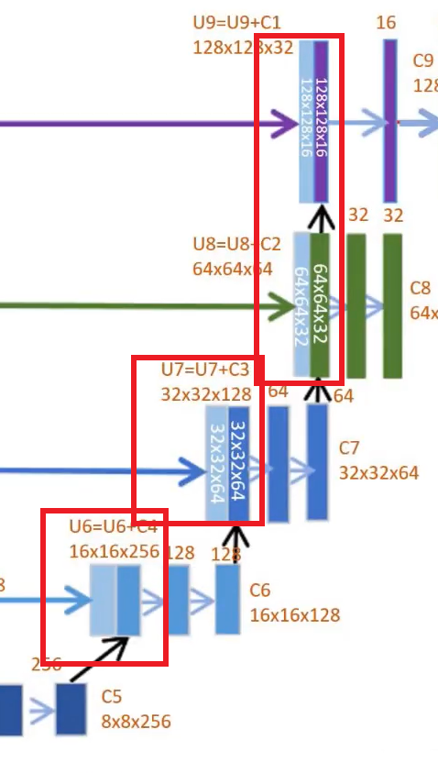
Up sampling using Transposed convolution
To get the “WHERE” of the segments.
Useful for localization of segments.
Low res to high res.

Slide 13
Evaluation metrics
Intersection over Union(IoU) and Dice Coefficient

Slide 14
Performance Metrics Used
Pixel by pixel accuracy is not a good measure to evaluate segmentation
It doesn't take into account class imbalance. This means a poorly segmented result might yield a high accuracy.
Here, we have used performance metrics such as :
IOU
DICE coefficient

Slide 15
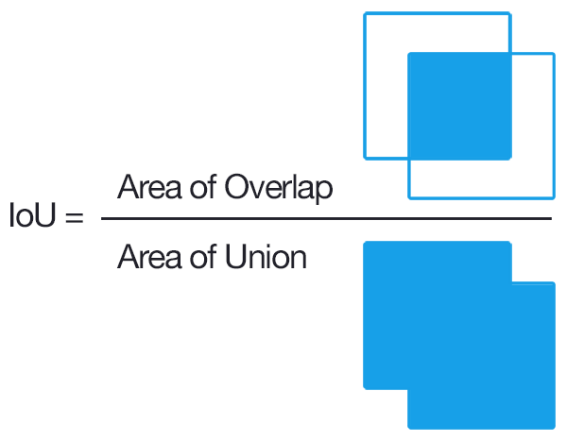

Intersection over Union
Higher overlap implies higher score.
In confusion matrix terms.

Slide 16
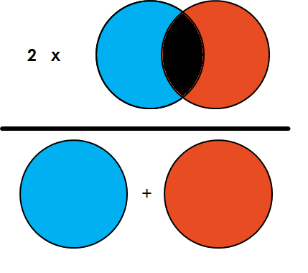

DICE Coefficient
DICE =
It calculates performance as a ratio of twice the area of intersection and total area.
In terms of confusion matrix :

Slide 17
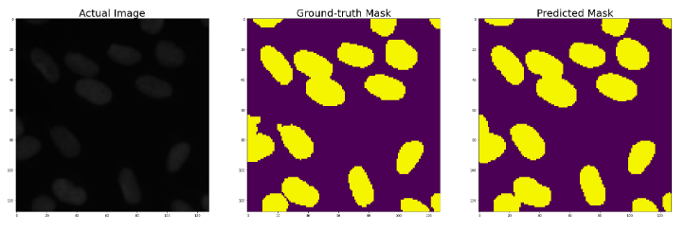
Input And Predicted Output
Unet gives a pretty good predicted mask.

Slide 18
Measured IOU, DICE and Confusion Matrix
IOU : 0.896
DICE coefficient : 0.941
Confusion Matrix :
Actual
 | Positive(White) | Negative(Black)
Positive | 0.189(TP) | 0.025(FP)
Negative | 0.009(FN) | 0.777(TN)
Predicted

Slide 19
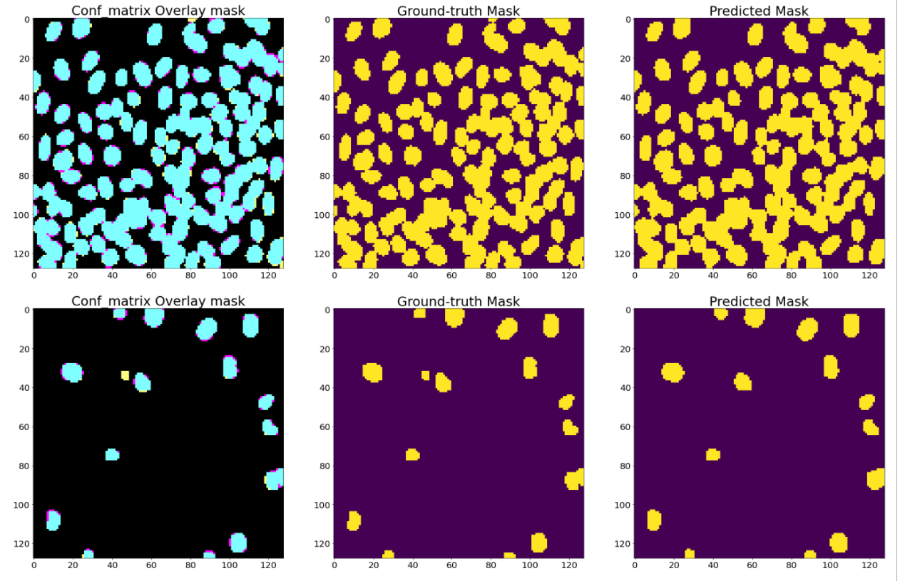
Conv. overlay matrix vs ground truth mask vs predicted mask
Cyan - TP
Magenta - FP
Yellow - FN
Black - TN

Slide 20
THANKS!
Group members -
Mukesh Singh 2018UCS0062
Vineet Bakshi 2018UCS0066

